Slide 2
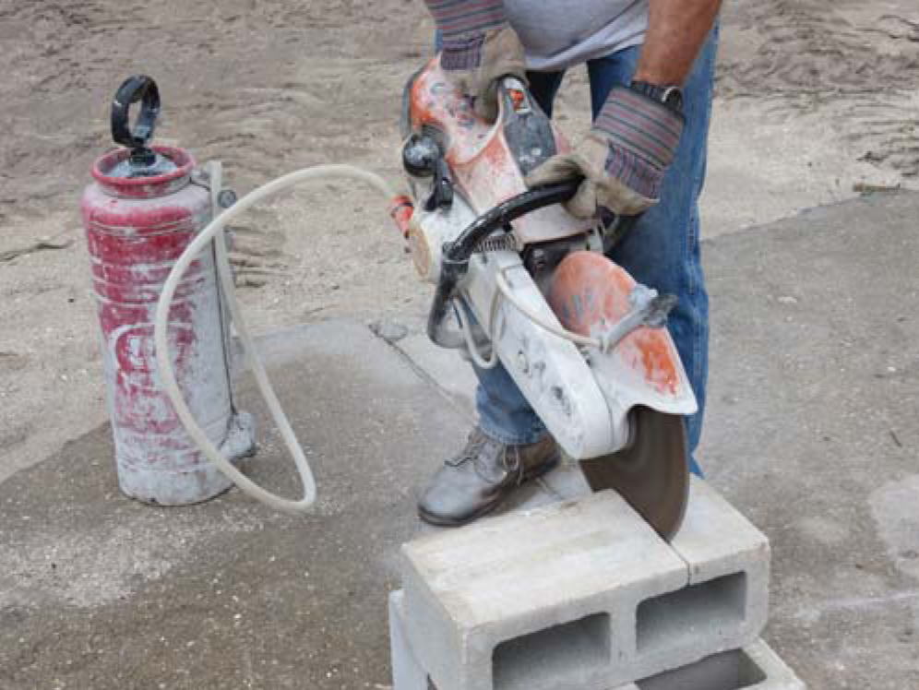
Section 4.1.0
Handheld Masonry Saws
  Can be powered by gasoline, electricity, or hydraulics
  Blade diameters up to 14 inches
  Must use extra caution when using a handheld saw
Notes:
Note: Review safety procedures for using masonry saws if necessary.

Slide 3
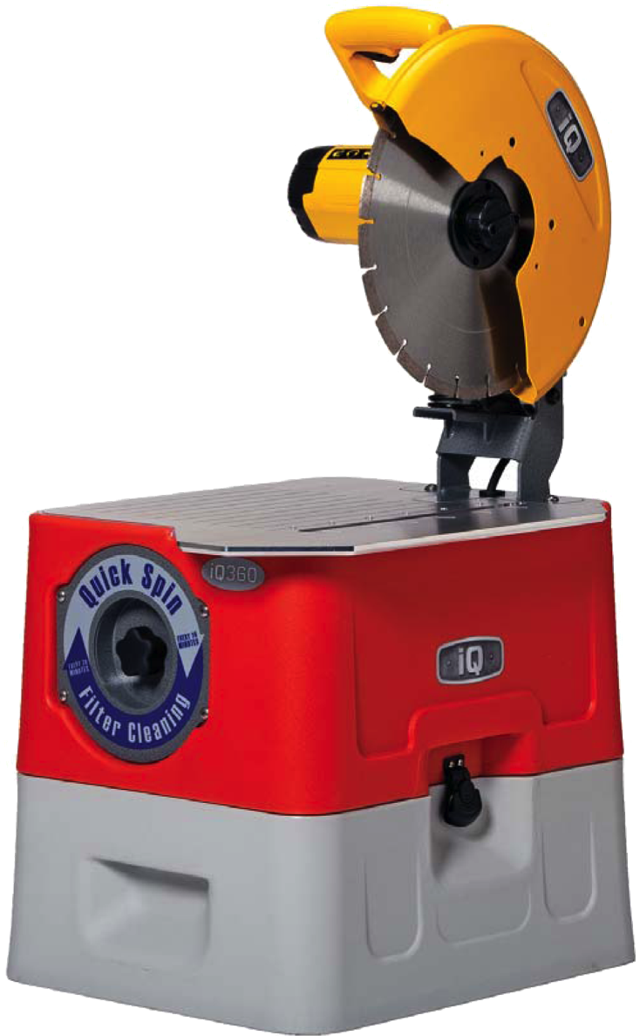
Section 3.3.0
Masonry Saws
  Use diamond or Carborundum™
  blades
    Diamond blades are often
    irrigated (wet cutting)
    Carborundum™ blades are
    not irrigated (dry cutting)
Notes:
Discuss the differences between diamond and carborundum blades.

Slide 4
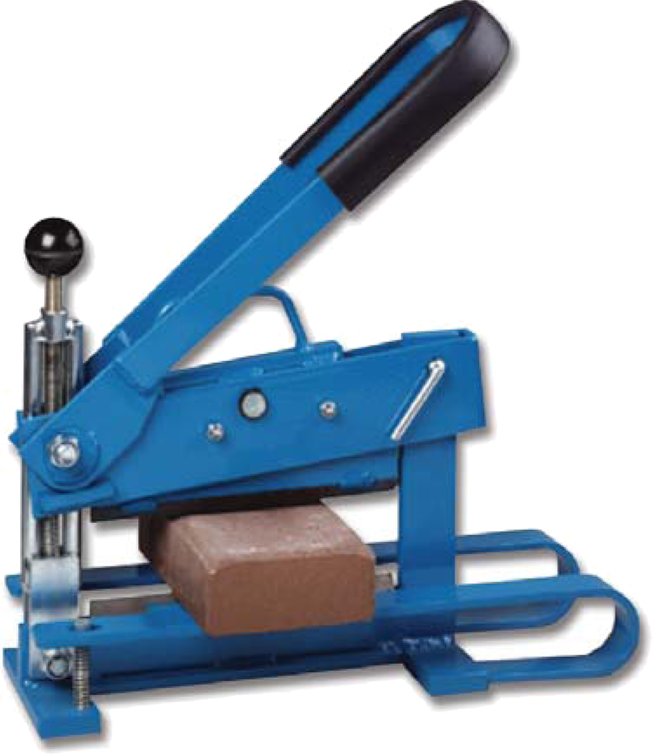
Section 3.3.0
Brick Splitters
  Accurate cuts
  Do not generate dust

Slide 5
Section 3.4.0
Checking Cut Masonry Units
  Know what finished unit should look like
  Mark all cutting lines before turning on saw
    Mark cutting lines in grease pencil for wet-cut saws
  Never cut cracked masonry units

