Slide 1
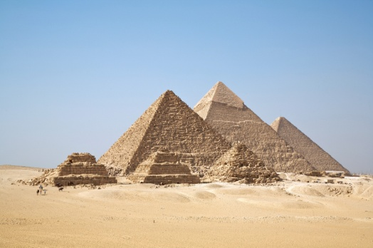
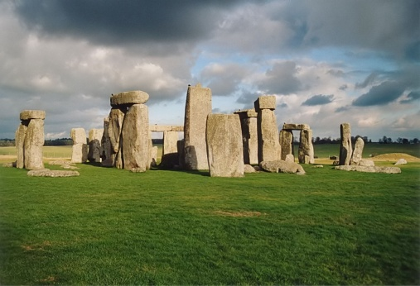
The History of Masonry
Masonry construction dates back 8000 years
Some of the world’s most significant architectural achievements have been built with masonry

Slide 2


Slide 3


Slide 4
History of Mortars
The first mortars were made from mud or clay. These materials were used because of availability and low cost
It was discovered that limestone, when burnt and combined with water, produced a material that would harden with age.
The Romans created hydraulic mortars that contained lime and a pozzolan such as brick dust or volcanic ash

Slide 5
History of Mortars
Joseph Aspdin, an English mason/builder patented a material called Portland cement in 1824
Portland cement combined with lime provided an excellent balance between strength and workability.
The addition of Portland cement to lime mortars increased the speed of the construction process for masonry building due to faster strength development

Slide 6
ASTM C-270
Specification for mortars:
  Proportion
  Properties

Slide 7
WHAT IS THE ROLE OF MORTAR?
Holds units together or hold units apart?

Slide 8
WHAT ELSE CAN GOOD MORTAR DO?
It accommodates for uneven units!
Mortar can fill non-uniform spaces between units to result in a plumb and level masonry wall.

Slide 9
Masonry Materials Basics
WHAT ABOUT THE WEATHER?
Water Penetration Resistance
Rain
Good mortar bonds the units together and proper tooling creates a water resistant masonry assemblage.

Slide 10
WHAT’S IN GOOD “MUD”?
  Cement
  Lime
  Sand
  Water
  Admixtures

Slide 11
Masonry Materials Basics
CEMENT: Provides structural performance
  Cement
  Lime
  Sand
  Water
  Admixtures
Portland Cement (C 150)
Masonry Cement (C 91), or
Mortar Cement (C 1329)
Compressive Strength
Early Setting
Bond Strength
Durability
Shrinkage

Slide 12
Masonry Materials Basics
LIME: Mortar’s secret weapon!
  Cement
  Lime
  Sand
  Water
  Admixtures
Hydrated Lime (C 207)
Workability
Water Retentivity
Late Strength
Autogenous Healing

Slide 13
Masonry Materials Basics
MASONRY SAND: The backbone of mortar!
  Cement
  Lime
  Sand
  Water
  Admixtures
Masonry Sand (C 144)
Bulk and Body
Yield
Strength
Shrinkage Resistance

Slide 14
MORTAR SELECTION: Based on two desired properties
1. Plastic Mortar 2. Hardened Mortar
– Workability – Bond strength and intimacy
– Water retentivity – Compressive strength
“board life” – Durability and resistance
– Stiffening characteristic
Other factors: Climate, seismicity, water penetration, shrinkage or color.

Slide 15
WHAT ARE THE ASTM C270 MORTAR DESIGNATIONS AND HOW WERE THEY DETERMINED?
M a S o N w O r K

Slide 16
MORTAR’S RECIPE SPECIFICATION!
ASTM C 270 Proportion Specification: Mortar by volume

Slide 17
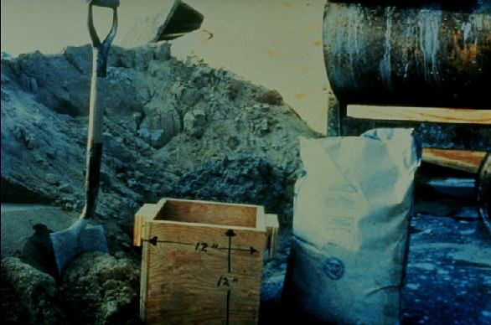
Mortar by Proportion

Slide 18
Type S Mortar (By Proportion)
Type S is the most common mortar is Arizona
Portland Cement / Lime Mortar
94# Bag Portland Cement = 1 cubic foot
50# Bag of Lime = 1 cubic foot
7 square shovels of Sand = 1 cubic foot (+ or -)
2 Portland Cement + 1 Lime = 3 C.F. Cementitious
3 C.F. X 2 ¼ to 3 C.F. Sand = 6 ¾ to 9 C.F. Sand
6 ¾ to 9 C.F. = 47 to 63 Shovels Damp Loose Sand
Most commonly used is 56 shovels of sand
This makes a “full mixer” of mortar

Slide 19
Mortar Property Specification

Slide 20
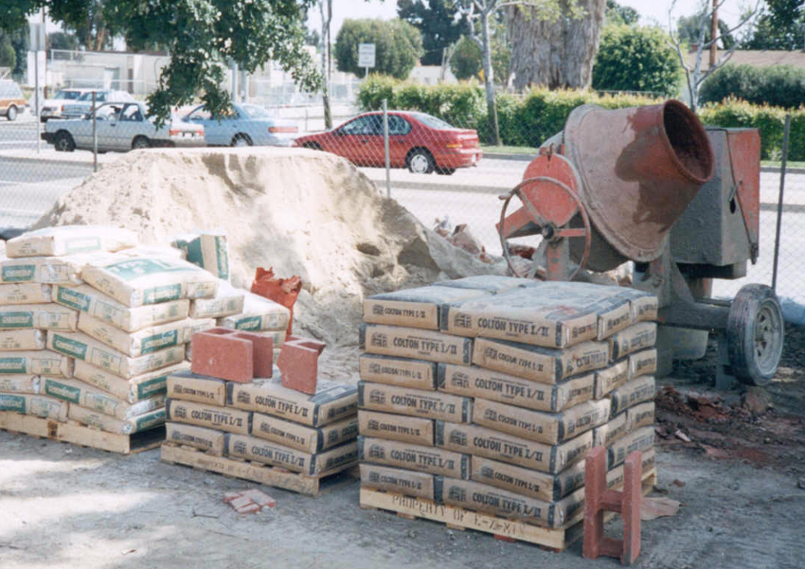
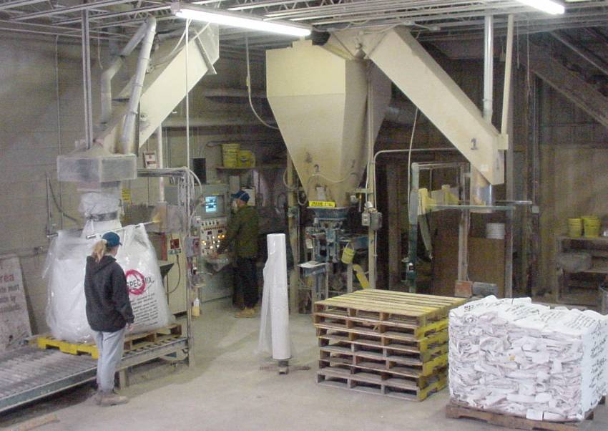
Two Ways to Make Mortar
Masonry Materials Basics
1. Field mixed 2. Preblended

Slide 21
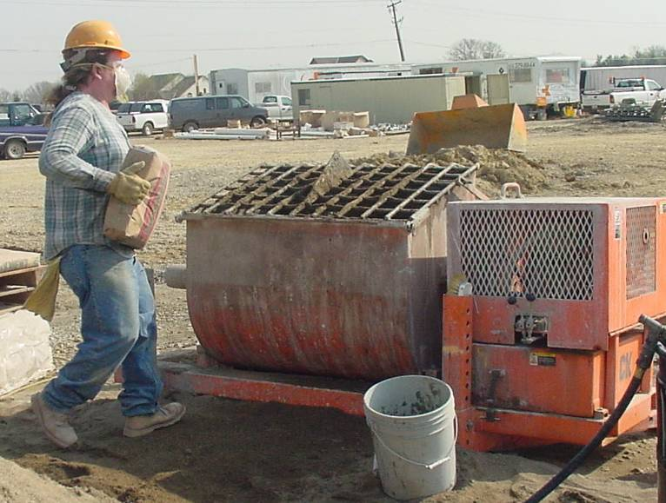
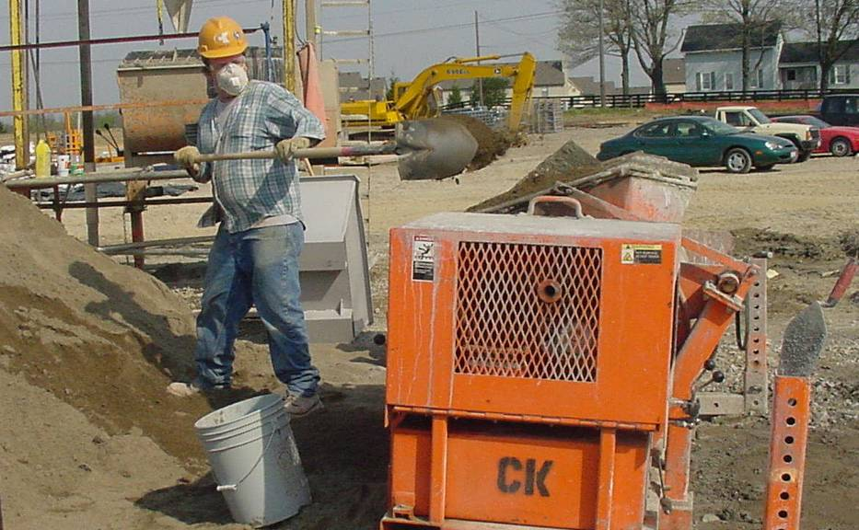
Field Mixed Mortar
Masonry Materials Basics
Twisting and turning
Heavy lifting

Slide 22
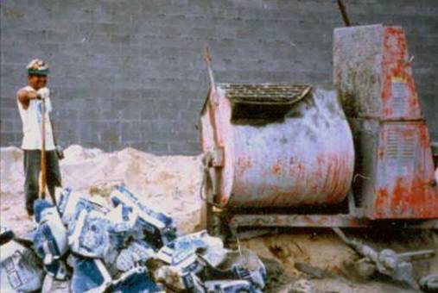
Masonry Materials Basics
FIELD MIX MORTAR QUALITY(?)
Is 20 shovels enough…
And, how much color?

Slide 23
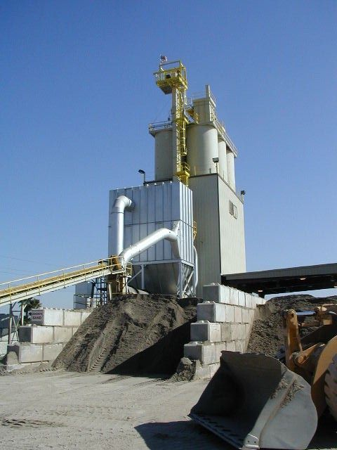
Amerimix Factory
Masonry Materials Basics
SUPERLITE

Slide 24
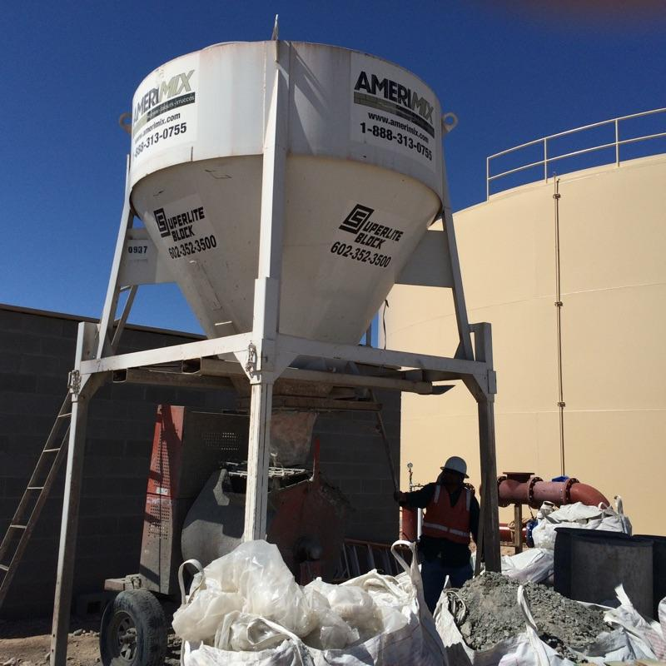

Slide 25
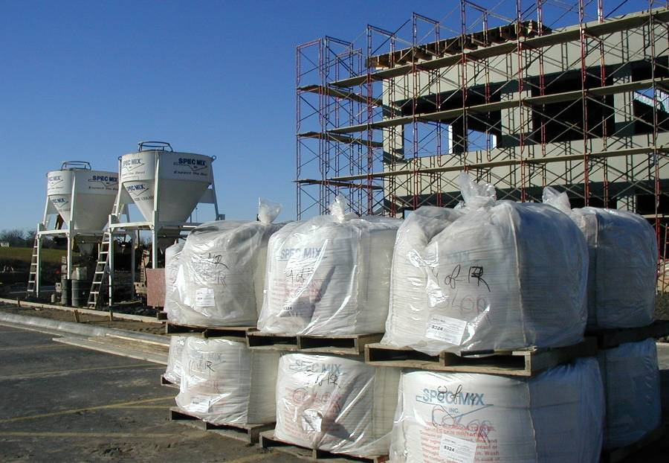
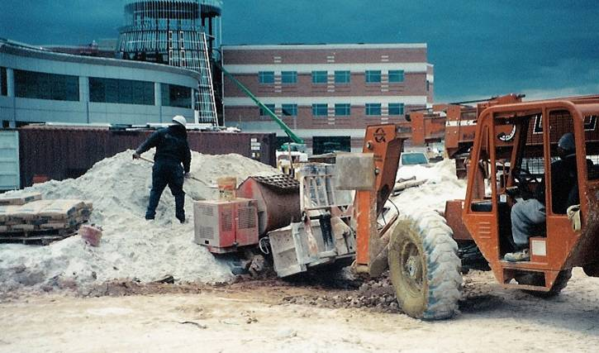
It’s Contamination Free
Masonry Materials Basics
What’s in the sand?
Soluble salts
Dirt mixed into the sand
Packaged completely dry and sealed tight!

Slide 26
Grout
What is Grout?
    A high slump concrete used to fill voids in the masonry assemblage to bind everything together.
Grout is specified either by:
  Proportions contained in C-476, or
  Strength (property) requirements
If compressive strength is not specified, minimum strength is 2000 psi at 28 days according to ASTM C 1019

Slide 27
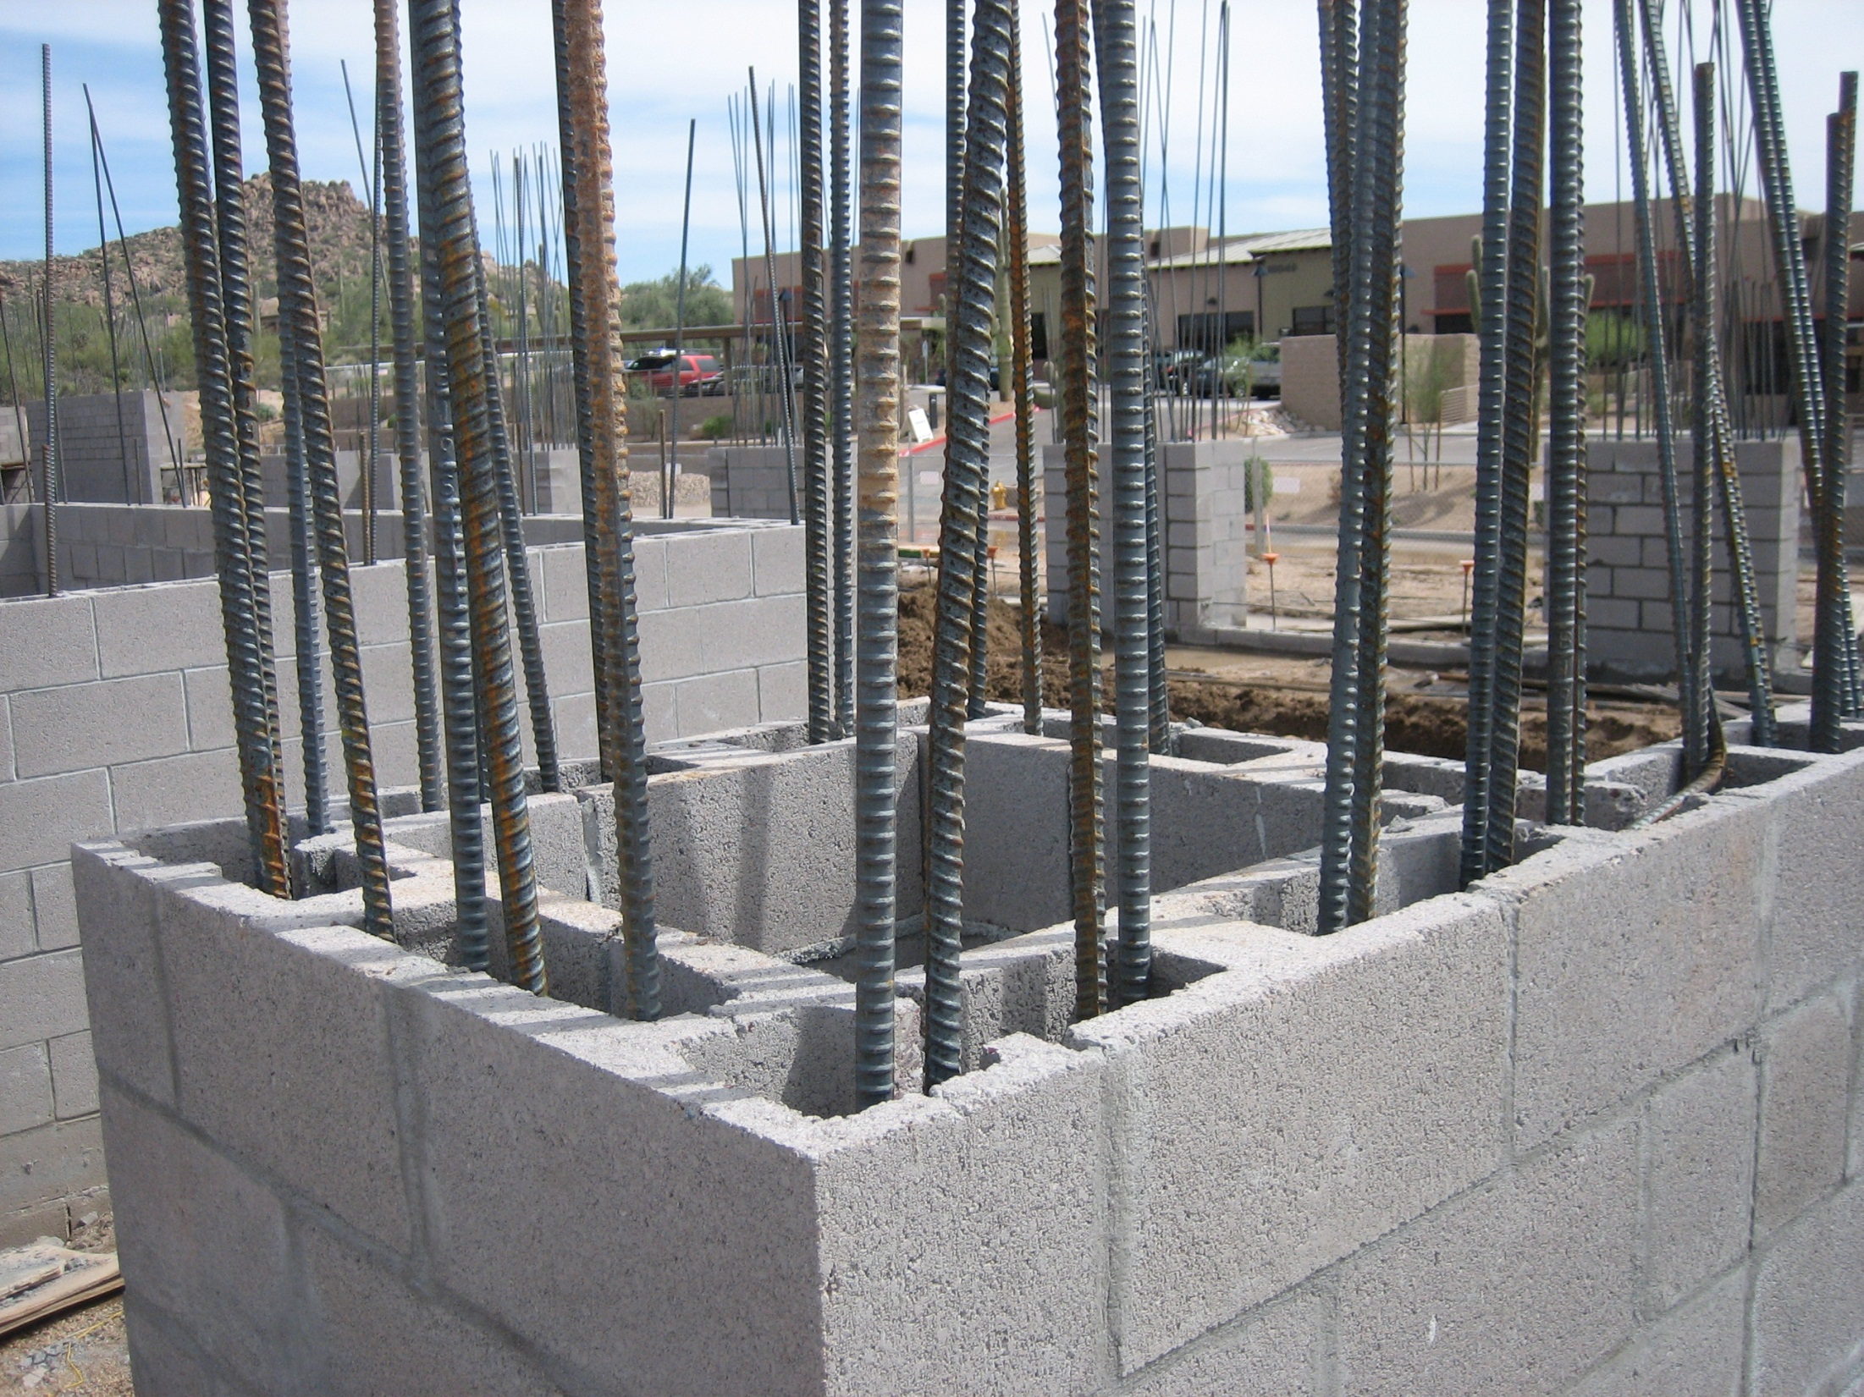

Slide 28
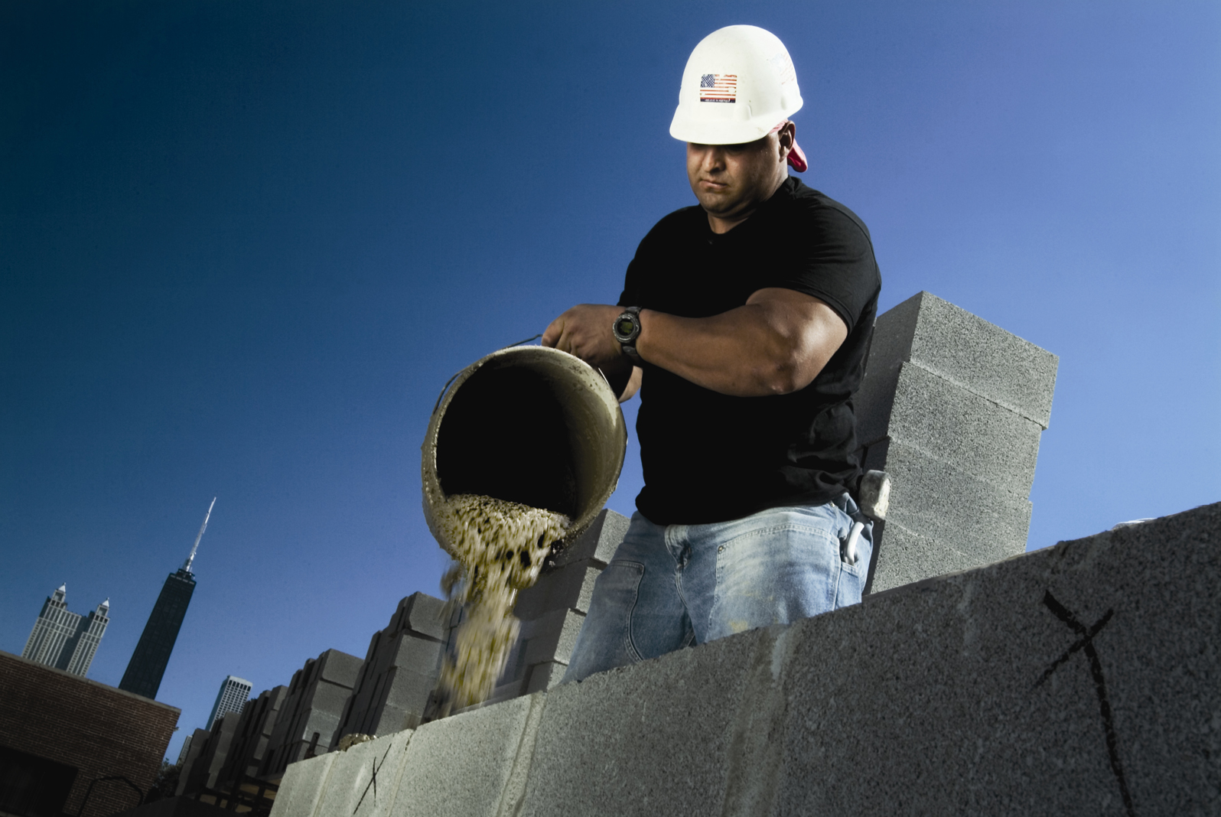

Slide 29
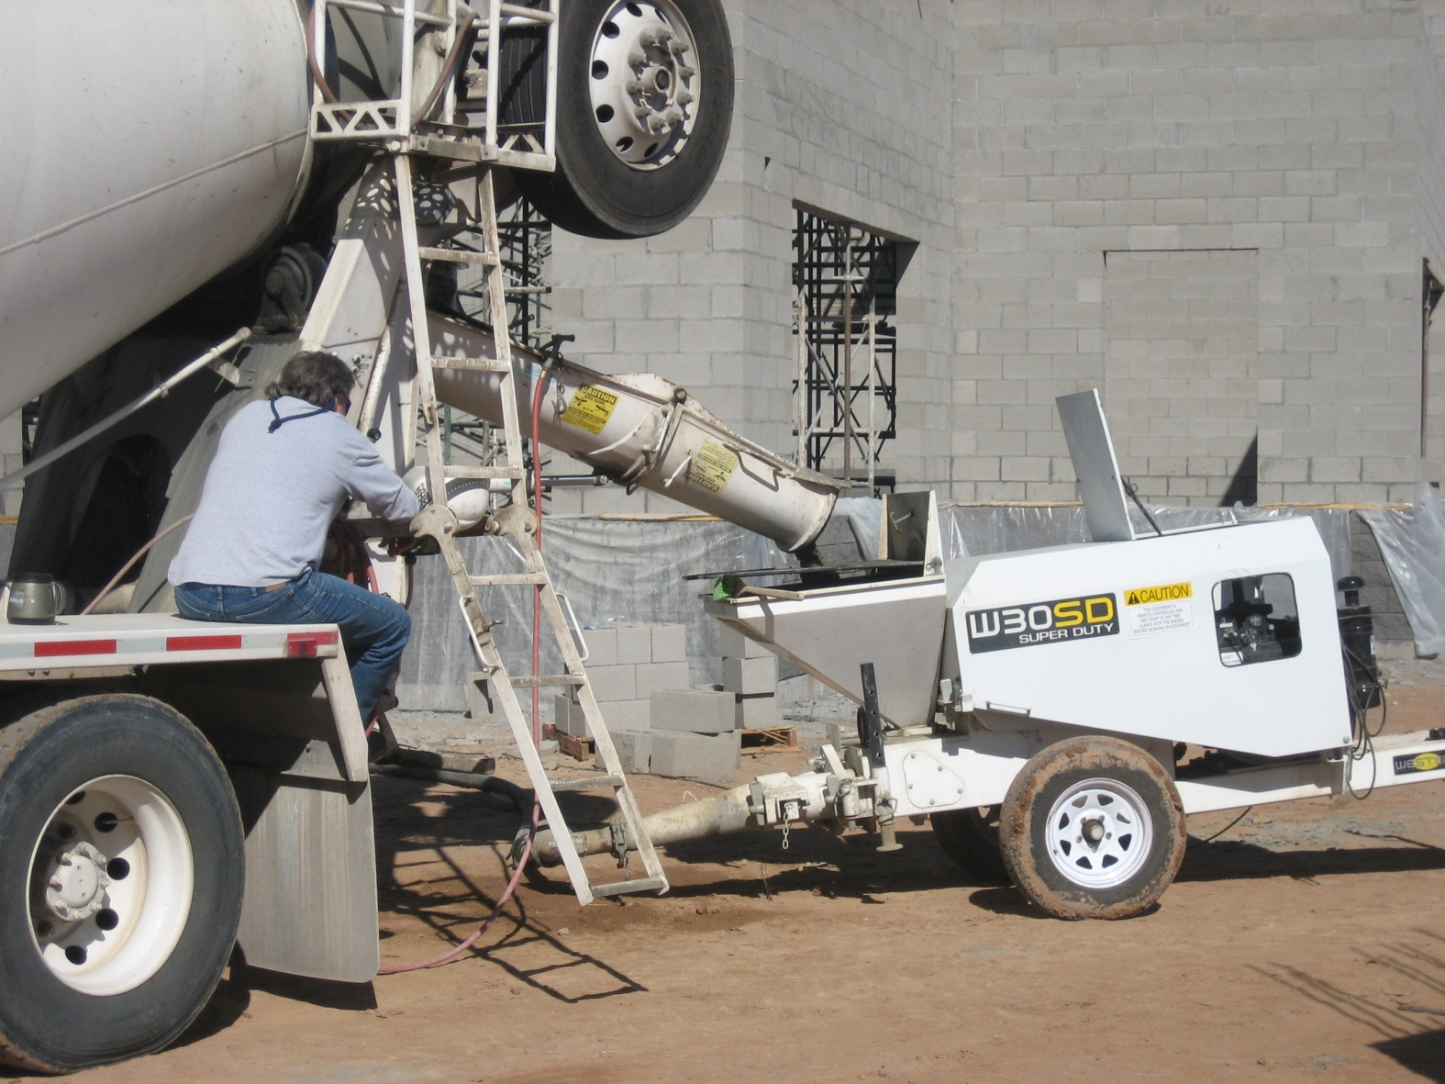

Slide 30
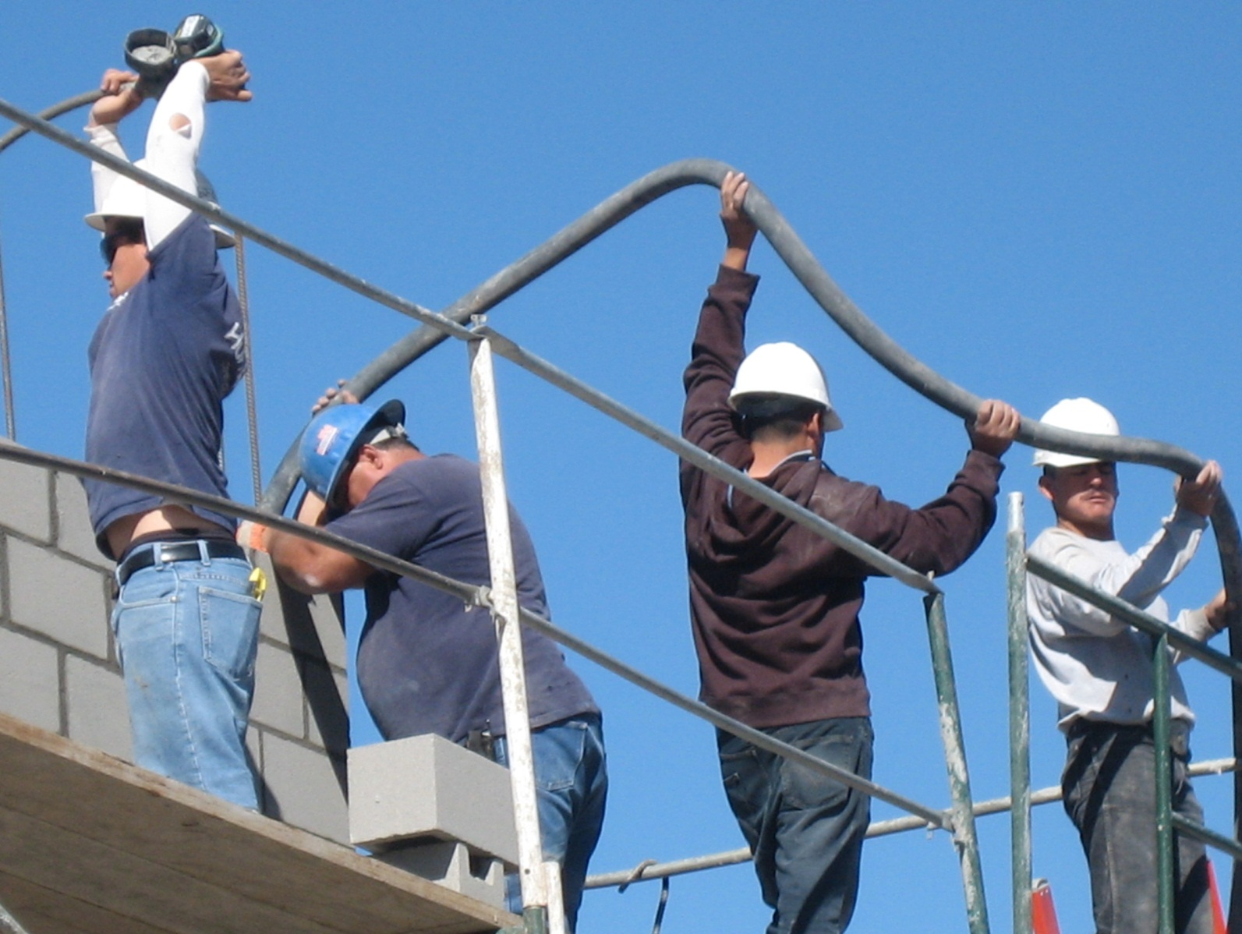

Slide 31
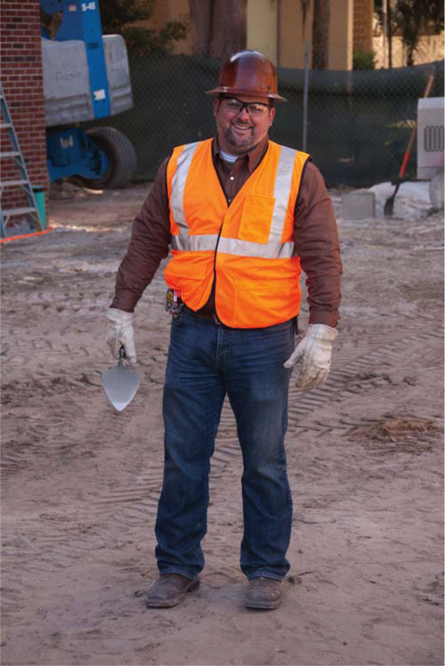
Proper Work Attire and PPE
Wear Goggles When
Cutting or Grinding.
Always Wear
a Hard Hat.
Wear Close-Fitting
Clothing.
Wear Long-Sleeved
Shirts to Give Extra
Protection if Skin
is Sensitive (Minimum
4-Inch Sleeve).
Wear Gloves When
Working With Wet
Mortar.
Wear High-Visibility Vest
(Where Required).
Belt Should
be Above Hips.
Ensure Pants
Do Not Sag (2-Inch
Maximum Inseam).
Wear Pants Over
Boots to Avoid
Getting Mortar
on Legs or Feet.
Keep Gloves and Clothing as Dry as Possible.
Notes:
Discuss with trainees the importance of each aspect of appropriate clothing and equipment for a mason.

