Slide 2
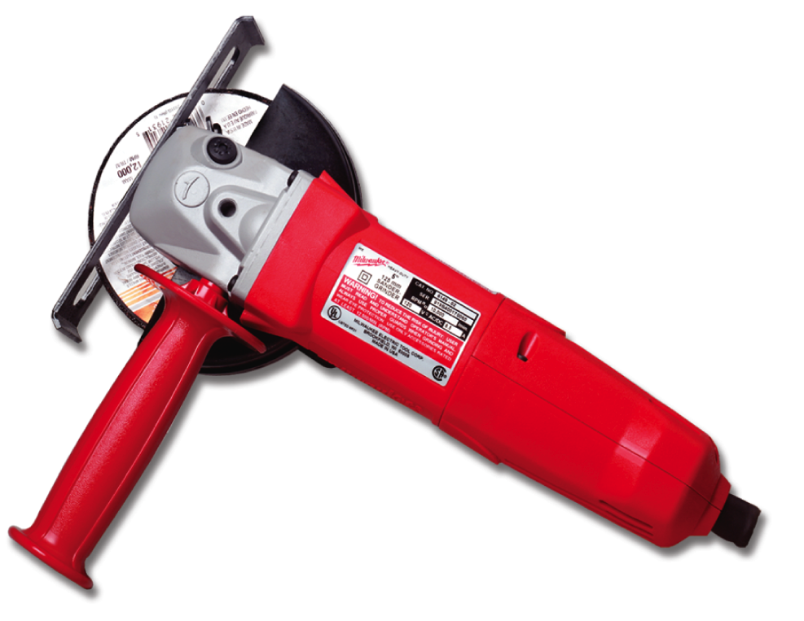
Section 4.4.0
Tuckpoint Grinder
  Grinds out old joints in masonry walls
  Has safety guard to prevent larger flying particles from contacting operators
Notes:
Note: Discuss safety guidelines for using a grinder.

Slide 3
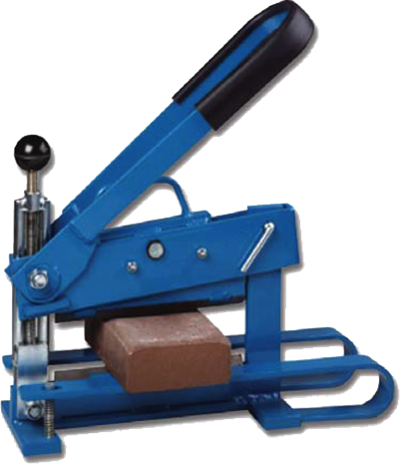
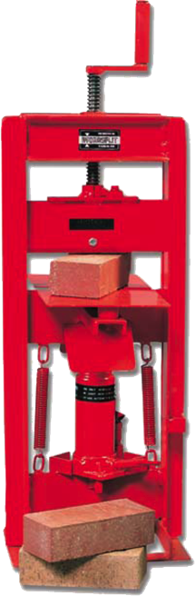
Section 4.2.0
Masonry Splitters
  Cut all types of masonry units
  Have no engines, but some
  use hydraulic power
  Have no blades
  Available in wide range of sizes
  Generate limited amount of dust
  Neat cuts
Notes:
Note:

Slide 4
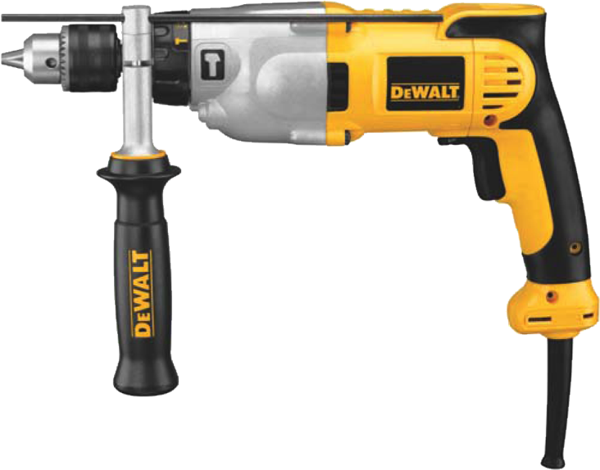
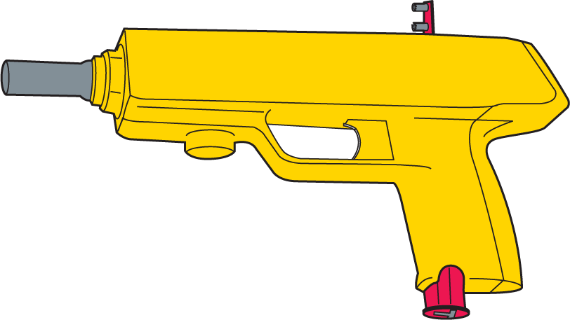
Section 4.4.0
Power Drills and Powder-Actuated Tools
  Power Drill
    Used to attach wall ties or other anchors
  Powder-Actuated Tool
    Uses an explosive charge to drive pins or studs
Notes:
Note: Discuss powder-actuated tool manufacturers’ use of color coding for powder load charges to identify the strength of the charge.

Slide 5
Section 5.0.0
Power Equipment Safety Guidelines
  Follow general rules for power tool safety
  Keep gasoline, liquid propane gas, and diesel fuel away from any source of fire
  Never have the three elements needed for fire in the same place at the same time.
  What are the three elements?
    1. Fuel
    2. Heat
    3. Oxygen
Notes:
Note: Discuss the importance of keeping areas where a forklift is used free of all flammable materials.

Slide 6
Section 5.0.0
Power Equipment Safety Guidelines (continued)
  Always work in well-ventilated areas.
  How do you create a “well-ventilated area”?
  Do not smoke or light matches or lighters when working with flammable materials.
  Store oily rags in metal containers.
  Where would oily rags come from?
  Store combustible materials only in approved containers.
  What type of combustibles are on a job site?

Slide 7
Section 5.0.0
Power Equipment Safety Guidelines (continued)
  Know the location and use of fire extinguishers. Ensure extinguishers are charged.
  Keep open fuel containers away from sources of sparks, fire, and extreme heat.
  Do not fill a fuel container while it is resting on a truck bed liner or other ungrounded surface.
  Why not?
  Always use approved containers for flammable liquids.
  List some flammable liquids found on a job site.
Notes:
Note: Explain that the tag must never be removed from a fire extinguisher because the tag indicates the date on which the extinguisher was last serviced and inspected.

Slide 8
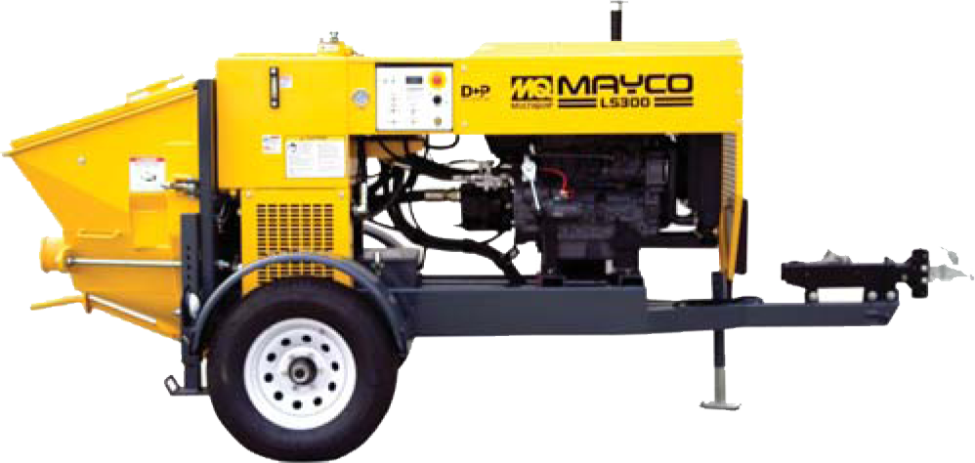
Section 5.2.0
Masonry Pump
  Used to deliver mortar or grout to high elevations
    Grout is used to fill cores in block walls
Notes:
Note: Ask trainees to explain the process of pumping grout from the mixer to the intake hopper of the grout pump to the delivery hose.

Slide 9
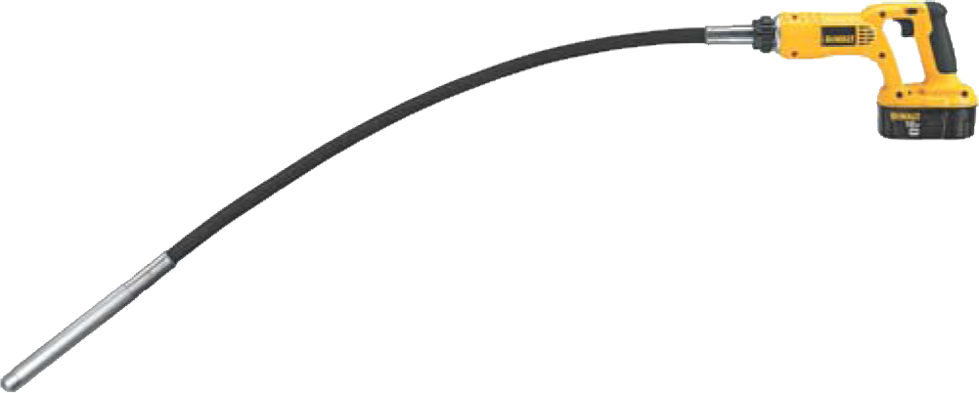
Section 5.2.0
Handheld Vibrator
  Used to eliminate air holes and consolidate grout

Slide 10
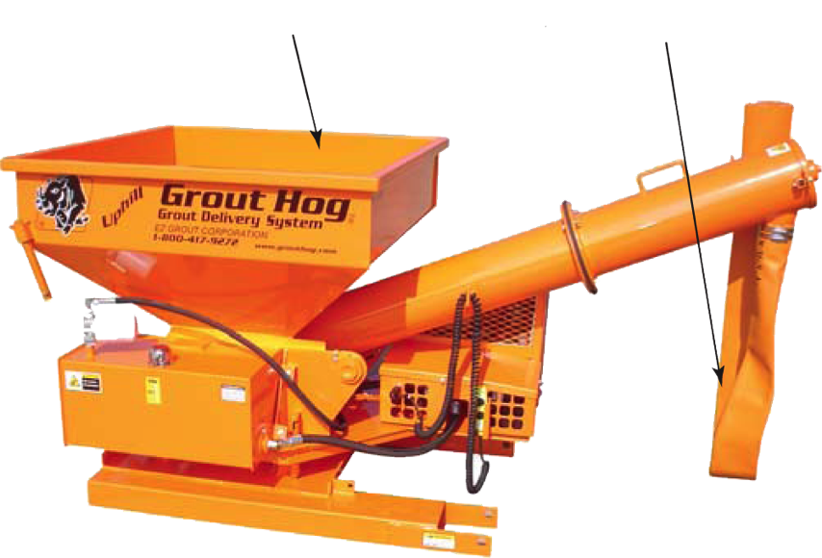
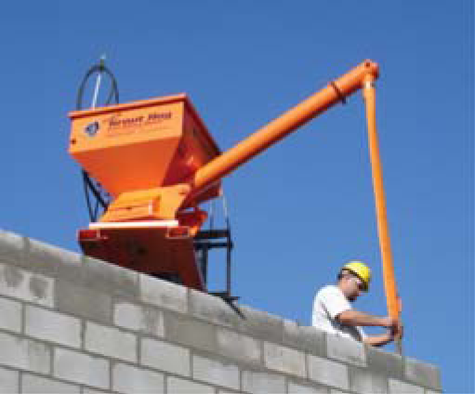
Section 5.2.0
  Hydraulic Grout Placer
  Used to pump grout to high elevations, over long distances, and around obstacles
  Has gasoline-powered piston pump
Hopper
Delivery Hose
Notes:
Note: Have trainees note that a mason directs the hose of the grout placer.

Slide 11
Section 5.3.1
Pressure Washer
  Uses compressed air pump to pressurize water and deliver it to focused area
  Use fan-type tip for cleaning masonry
  Water volume more important than pressure
    Minimum water flow = 4 to 6 gallons per minute
    Water pressure = 400 to 800 psi
  Must keep water stream moving to avoid damage to masonry
Notes:
Note: Discuss the results of improper pressure washing techniques.

