Slide 2
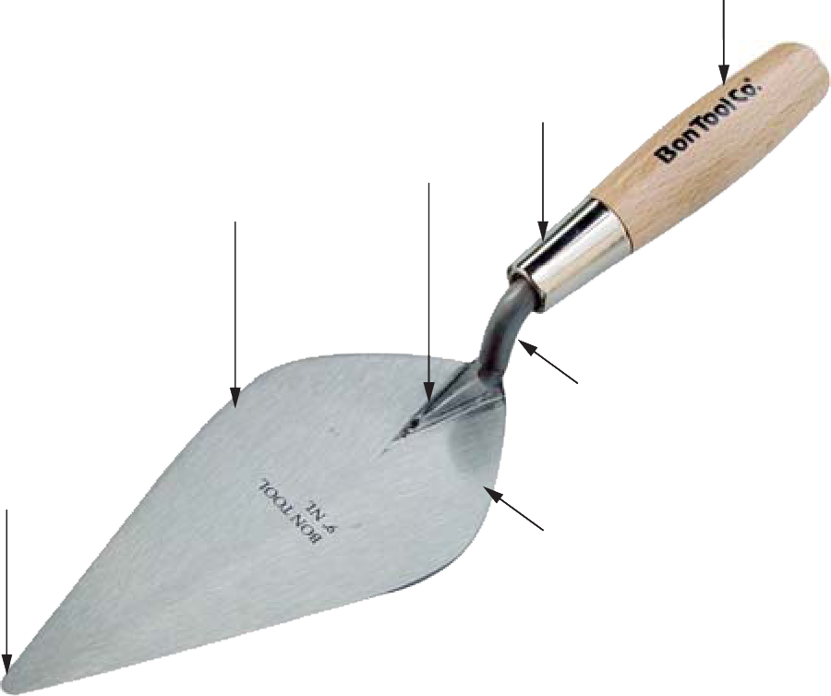
Kickoff Activity
Identify the parts of the trowel.
Describe some tasks that masons perform with a trowel.
Handle
Ferrule
Frog
Blade
Point
or Toe
Shank
Heel

Slide 3
Section 1.0.0
Caring for Tools
  Repair or replace defective tools and equipment immediately
  Clean tools and equipment that contact mortar or grout with a wire brush immediately after use
  Soak tools to be used again shortly in a bucket of water
  Keep wood handles out of water
Notes:
Note: Explain that if mortar dries on a tool, it will harden and make the tool unusable.

Slide 4
Section 1.0.0
Caring for Tools (continued)
  Lightly coat tools not used often with oil
  After cleaning, check that tool handles are secure and are damage-free
  Oil pivot joints and wood parts of tools
  Sharpen dull or nicked blades and cutting edges

Slide 5
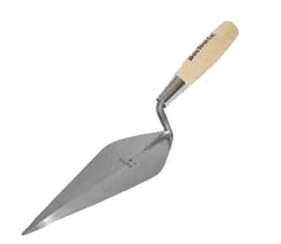
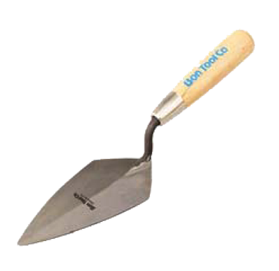
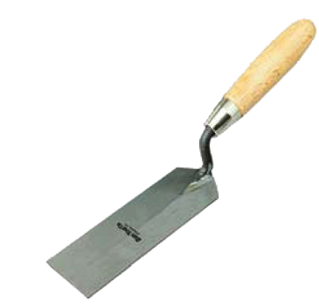
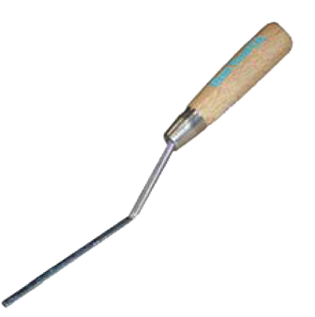
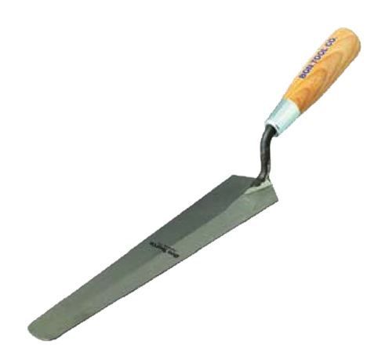
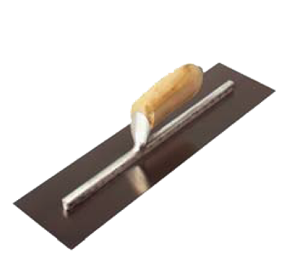
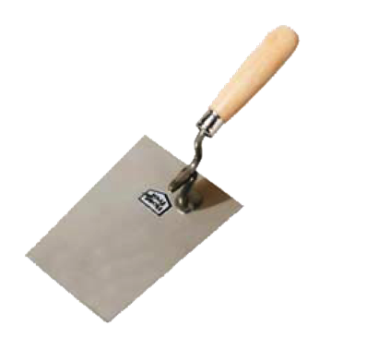
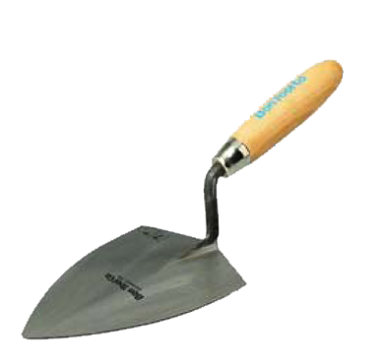
Section 1.1.0
Types of trowels
Brick
Pointing
Margin
Tuckpointer
Parging
Duck Bill
Bucket
Tile-Setting
Notes:
Have trainees identify uses of each type of trowel. Point out that some of these trowels have specialized uses and are not used often, while others are particular to certain parts of the country.

Slide 6
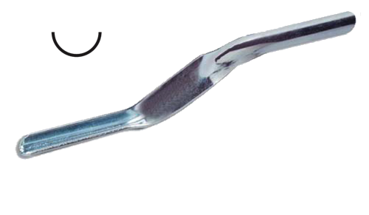
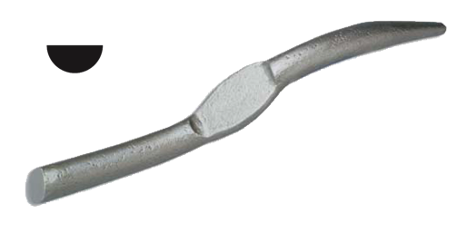
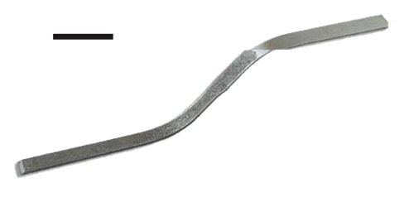
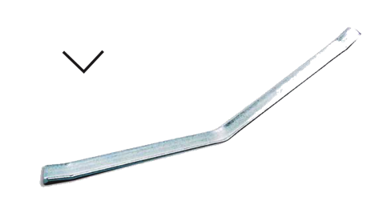
Section 1.3.1
Simple Jointers
  Used to compress and
  decrease surface water
  absorption
  Used for short vertical
  and head joints
  Jointer profile determines
  joint appearance
End View
Convex Jointer
(Cupped Joint)
End View
Round Jointer
(Concave Joint)
End View
Flat Jointer
(Flush or Raked Joint)
End View
V-Jointer
(V Joint)
Notes:
Note: Explain that longer jointers with wooden handles, called sled runners, are used for the horizontal joints.

Slide 7



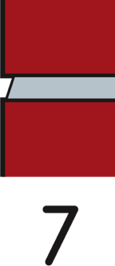





Section 1.3.1
Tooled Mortar Joints
  Created by jointers
  Jointers compress
  mortar into joint
Concave
“V”
Grapevine
Weathered
Beaded
Struck
Flush
Raked
Extruded
Notes:
Note: Longer jointers with wooden handles are used for the horizontal joints.

Slide 8
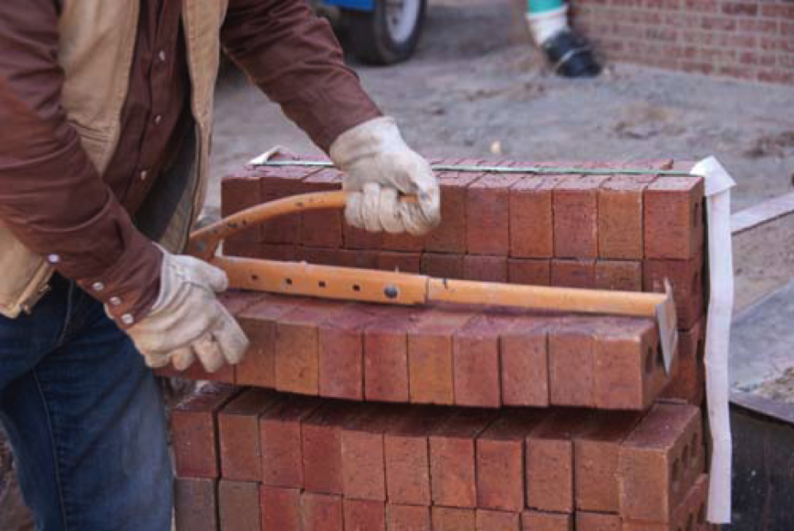
Section 1.4.0
Brick Tongs
  Carry brick without chipping or breaking them
  Usually consists of adjustable steel clamp with locking nut and handle
  Can be adjusted to hold 6 to 11 masonry units
Notes:
Note: Explain that bricks can also be carried by a brick carrier, a steel rod that fits into the holes in the brick and is held upright.

Slide 9
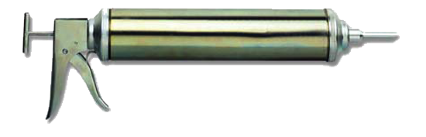
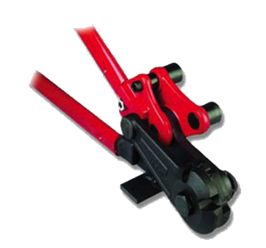
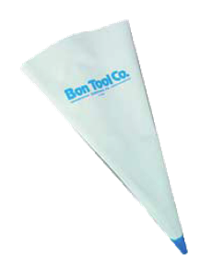
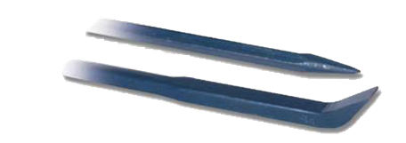
Section 1.4.0
Miscellaneous Masonry Tools
  Bulk gun—used to add caulk to expansion joints
  Bolt cutters—used to cut reinforcing wire or ties
  Grout bag—used to apply grout between masonry units
  Pinch bar—used to pry out masonry units
Bulk Gun
Bolt Cutters
Grout Bag
Pinch Bar
Notes:
Note: Have trainees note that a grout bag has a metal or plastic tip, and that the bag is squeezed to apply the grout.

Slide 10
Section 2.1.0
Standard and oversize brick
spacing rule
  Used to lay out and space
  standard brick courses
  Shows course spacing for
  each joint size
Modular spacing rule
  Based on a module of 4"
  Can be used for block
  and brick
Standard Brick
Spacing Rule
Oversize Brick
Spacing Rule
Modular Brick
Spacing Rule
Notes:
Note: Explain that a brick spacing rule is useful for spacing mortar joints around door tops, window tops, and other uneven spaces.

Slide 11
Section 4.0.0
Avoid Misuse of Tools
  Do not:
    Use trowels as hammers.
    Hit a level.
    Use hammers as chisels.
    Use levels or trowels as pry bars.
    Use broken or defective tools.
    Cut reinforcement with hammers, chisels, or trowels.

Slide 12
Section 4.1.0
Caring for Hand Tools
  Always keep:
    Mason’s hammers sharp and square.
    Folding rules oiled.
    Chisel blades sharp.
    Chisel heads and blades free of burrs.
    All tool handles tight.

Slide 13
Section 2.2.0
Levels
  Can be used to plumb and level:
    Plumb line is vertical to Earth surface
    Level line is horizontal to Earth surface
  Has an air bubble in a sealed vial filled with oil or alcohol
  When the bubble is centered between vial’s markers, object being checked is plumb or level
Notes:
Note: Point out that some levels have a double set of bubble vials. Discuss proper care of levels.

Slide 14
Section 2.4.0
Mason’s Line
  Guide for laying out masonry courses
  Made of twisted or braided (preferred) nylon cord
  Stretched tight between two fixed points, usually on wall corners
Methods of fastening lines in place:
  Pins
  Blocks
  Stretchers
Notes:
Note: Explain that braided line is preferred because it does not sag as much as twisted line when it is pulled tight and also lasts longer.

Slide 15
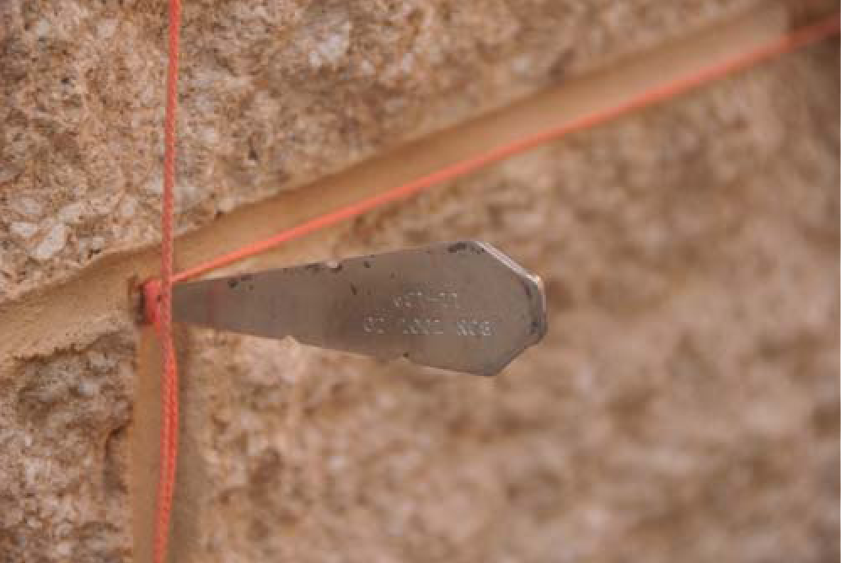
Section 2.4.0
Line Pins
  Driven into a wall or structure
  Mason’s line is stretched tightly between them
Notes:
Note: Explain that line pins leave holes, and the string has to be remeasured or retightened for each course.

Slide 16
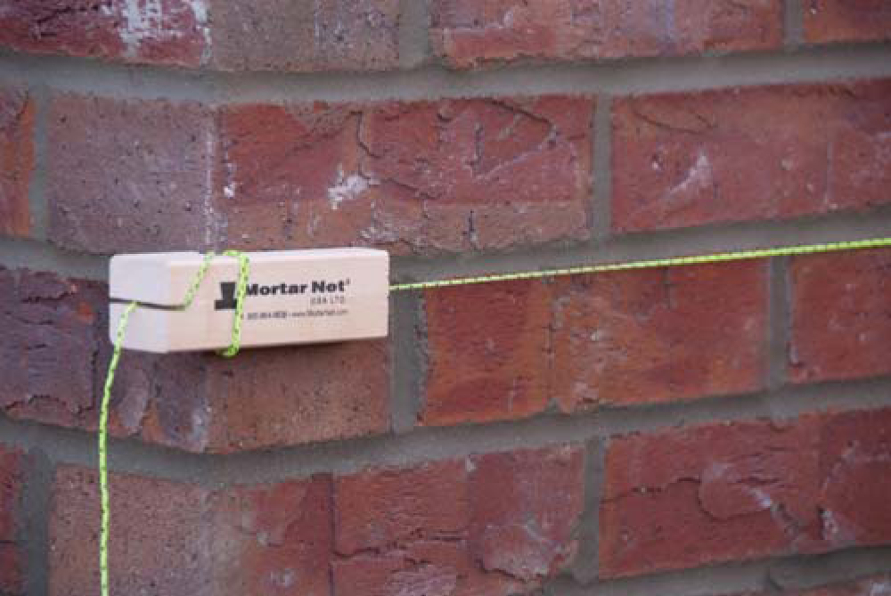
Section 2.4.0
Corner Blocks
  Made of wood, plastic, or metal
  Knotted line passes through slit in back of block
  Line tension between two blocks holds them in place
Notes:
Note: Discuss why blocks made of wood grips corners better that those made of plastic or metal.

Slide 17
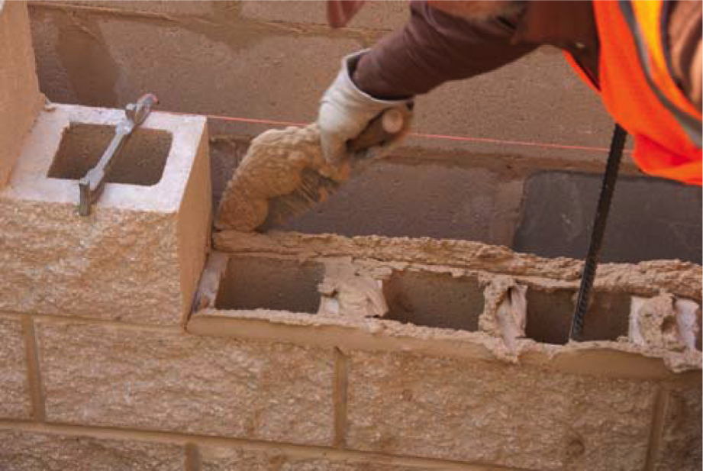
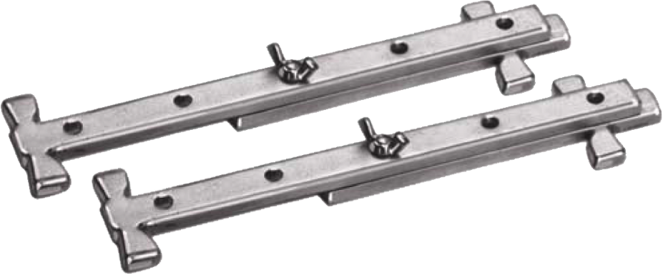
Section 2.4.0
Line Stretchers
  Available in standard and adjustable sizes
  Line tension holds them in place
  Fit more snugly to the lead than corner blocks
Notes:
Note: Point out that unlike pins, stretchers as well as blocks must have a corner to be held snugly against.

Slide 18
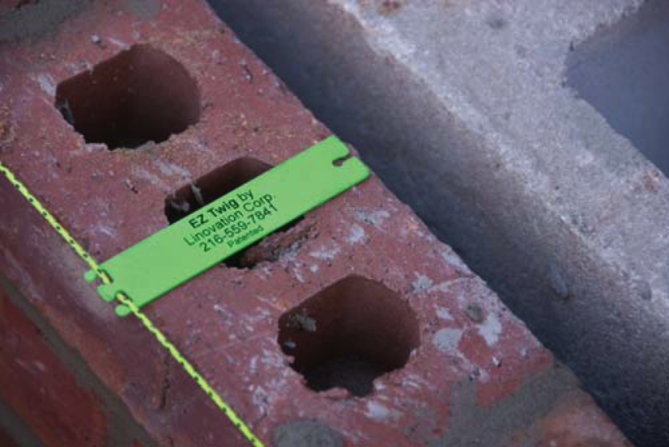
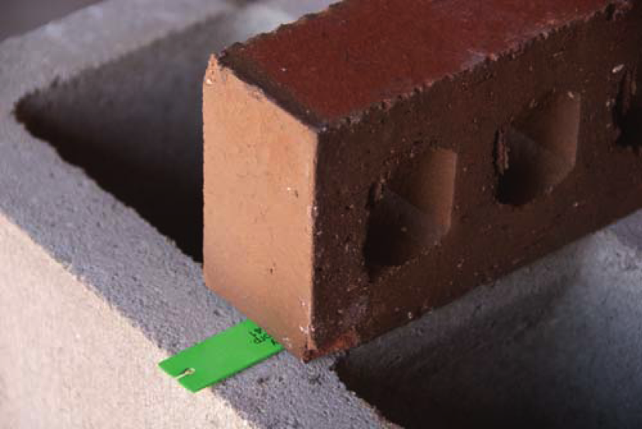
Section 2.4.0
Line Trigs
  Hold mason’s line in position and keep it from sagging
  Line slips into trig; trig rests on a masonry unit

